Slide 1
LECTURE 2

Slide 2

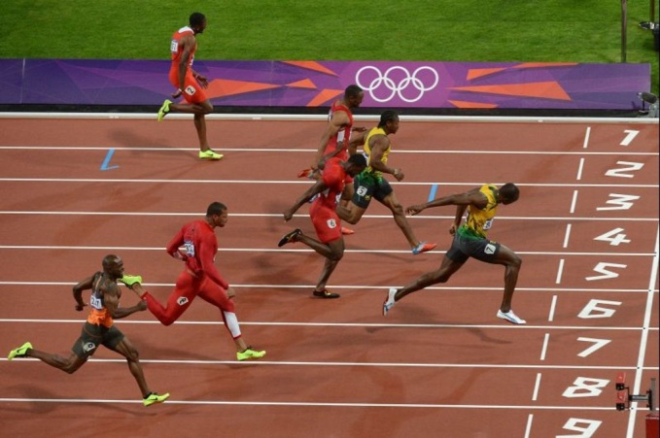



Physical Quantities
Anything that can be measured is a PHYSICAL QUANTITY.
TIME IS A PHYSICAL QUANTITY
DISTANCE IS
A PHYSICAL QUANTITY
LOVE IS NOT A PHYSICAL QUANTITY

Slide 3
UNITS
Units are a system of measurement.
M.K.S. System
C.G.S. System
meter–kilogram–second
centimeter–gram–second
S.I. System
System International units
OR
Standard International units

Slide 4

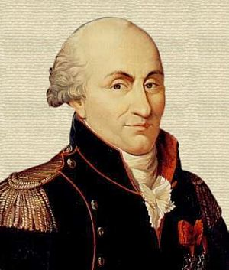
coulomb (C) :
S.I. unit of ELECTRIC CHARGE (Q)
Two like point charges
The charge of an electron is 1.6 × 10⁻¹⁹C
Equal magnitudes
The magnitude of charge on a particle is given by formula
Q = ne
∴ n =
Placed in a vacuum
1 m
+
–
+
Distance of one meter from each other
1
–
1
Electric charge is measured by coulomb
9 × 10⁹ N
Q
Repel each other
Vacuum
e
1
9 x 10⁹ N
∴
n
=
1.6 × 10^{–19}
Each charge is called as “one coulomb”.
∴
n
=
0.625 × 10¹⁹
∴
n
=
6.25 × 10¹⁸
Sir COULOMB

Slide 5
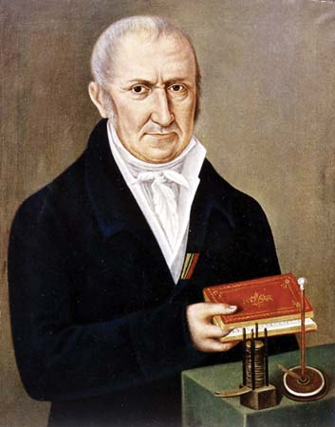


volt (V) :
S.I. unit of potential difference (V)
Scientist who discovered voltaic cell
Volt is a unit for measuring potential difference
Volta

Slide 6
volt (V) :
S.I. unit of potential difference (V)
Work done in
moving the charge
Charge
W
W
V =
Q
Q
1
joule
1
volt
=
1
coulomb
1 V
=
1 J C⁻¹
+
▬
V
1 volt is the potential difference between two points in a current carrying conductor when 1 joule of work is done to move a charge of 1 coulomb from one point to another.
Potential difference
1
1
1kV
1mV =
=
=
10⁻³ V
= 10³V
1000 V
10³ V
1MV
= 10⁶V

Slide 7
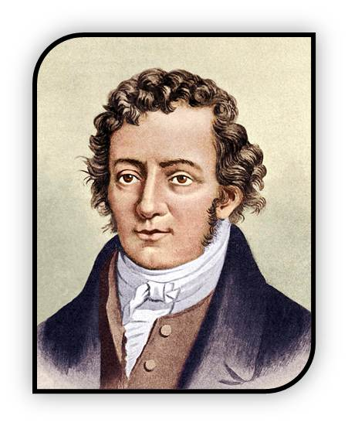
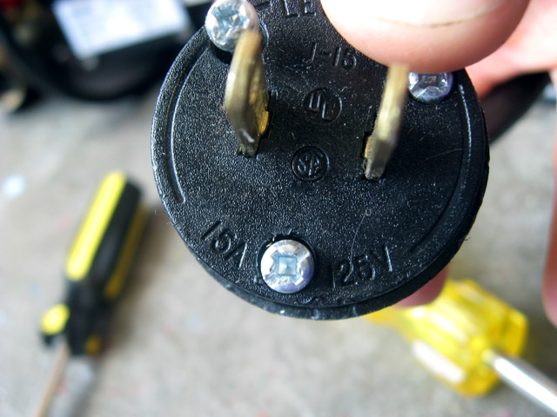
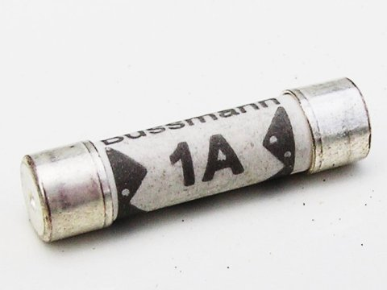
ampere (A) :
S.I. unit of ELECTRIC current (I)
Q
I =
t
Sir Andre Marie Ampere
Electric
Current
Electric Charge
=
Time
t
1
coulomb
Time
1
ampere
=
+
▬
1
second
Q
One ampere is constituted by the flow of one coulomb of charge in one second.
Electric charge
Ampere is the unit for measuring electric current
Ampere
1
1
1mA =
=
=
10⁻³ A
1000 A
10³ A

Slide 8
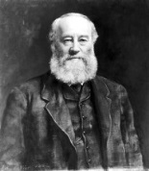
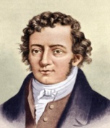
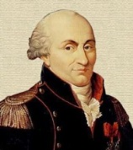
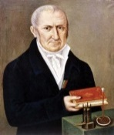
Match the following :
I
Answers
II
ampere
(i) Electric current (I)
(a) joule (J)
(b) ampere (A)
coulomb
(ii) Electric charge (Q)
(c) coulomb (C)
(iii) Potential difference (V)
volt
(d) volt (V)

Slide 9
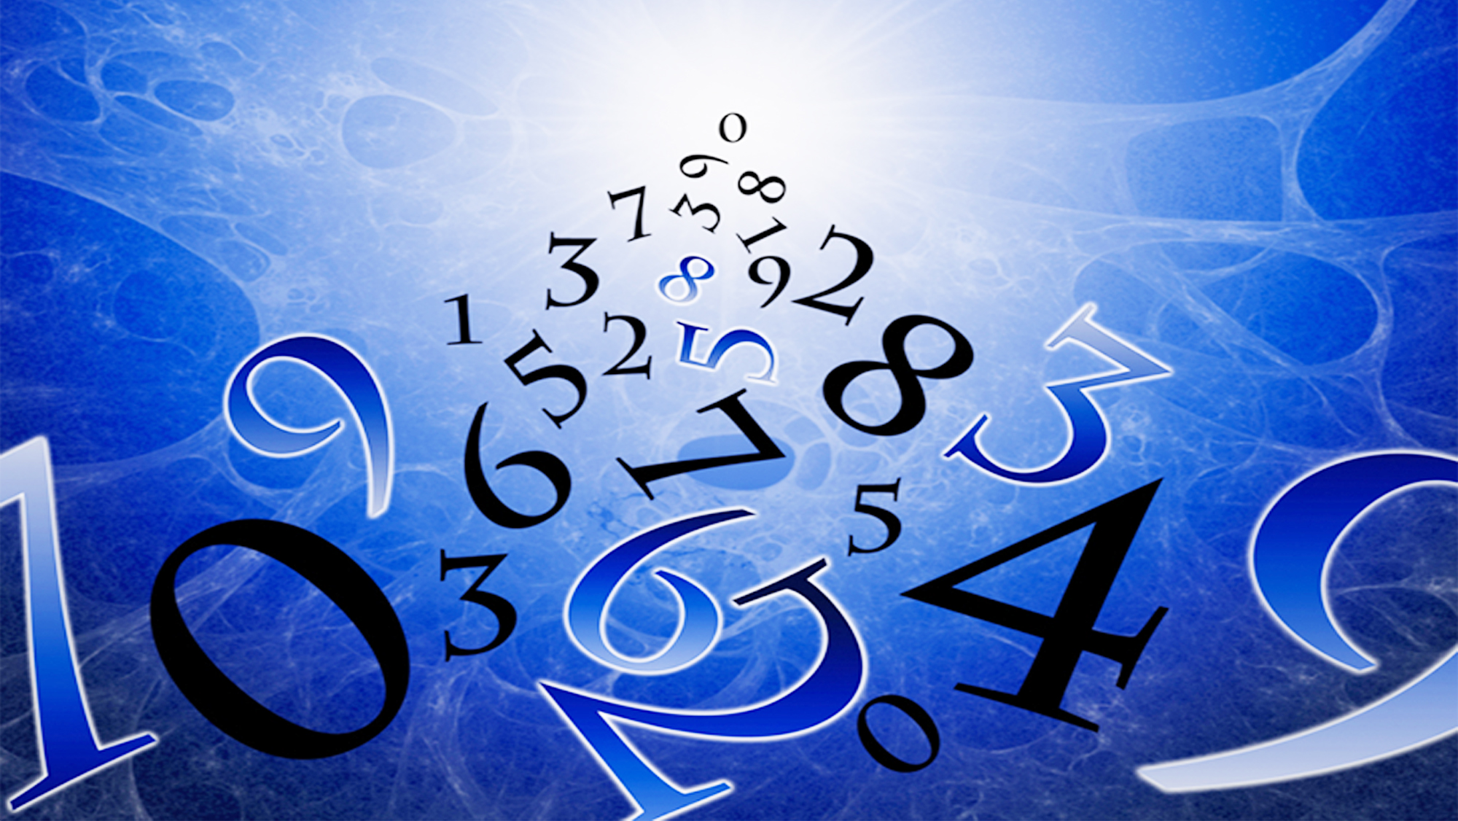

Type - A
Q = It
numerical
W = VQ
Q = ne

Slide 10

Q.1.
A current of 0.5 A is drawn by a filament of an electric bulb for 10 minutes. Find the amount of electric charge that flows through the circuit.
Given :
Current (I)
= 0.5 A
Time (t)
= 10 min
= 10 × 60 sec.
= 600 sec.
To find :
Charge (Q)
= ?
Formula :
Q =
It
The charge flowing through circuit is 300 C
Solution :
Q =
It
∴
Q =
0.5
× 600
∴
Q =
300 C

Slide 11
Q.2.
How much work is done in moving a charge of magnitude 2 C from a point at 118 volts to a point at 128 volts ?
Given :
Charge (Q)
= 2 C
Potential difference (V)
= 128 V – 118 V = 10 V
To find :
Work (W)
= ?
Formula :
W =
VQ
Solution :
W =
VQ
∴
W =
10
× 2
The work done is 20 J
∴
W =
20 J

Slide 12
Q.3.
Calculate the number of electrons constituting one coulomb of charge. OR
Show that 1 ampere is equivalent to flow of 6.25 × 10¹⁸ elementary charges
Given :
Charge on an electron (e)
= 1.6 × 10^{–19} C
Charge(Q)
= 1C
To find :
No of electrons (n)
= ?
Formula :
Q =
ne
Solution :
Q =
ne
Number of electrons constituting one coulomb of charge is 6.25 × 10¹⁸
1
∴
n =
1.6 × 10⁻¹⁹
∴
n =
6.25 × 10¹⁸

Slide 13
Q.4.
How much work is done in moving a charge of magnitude 2 C across two point having a potential difference of 12 V ?
Given :
Charge (Q)
= 2 C
Potential difference(V)
= 12 V
To find :
Work (W)
= ?
Formula :
W =
VQ
Solution :
∴
W =
12 × 2
∴
W =
24 J
The work done is 24 J

Slide 14
Q.5.
How much energy is given to each coulomb of charge passing through 6 V battery ?
Given :
Charge (Q)
= 1C
Potential difference (V)
= 6V
To find :
Energy given by battery (W)
= ?
Formula :
W =
VQ
Solution :
W =
VQ
∴
6 × 1
W =
∴
W =
6 J
The energy given by battery is 6 J

Slide 15
Q.6.
How many electrons are flowing per second past a point in a circuit in which there is a current of 5 amp ?
Given :
Current (I)
= 5 A
It
= ne
Time (t)
= 1sec
It
∴
n =
e
Charge on electron (e)
= 1.6 × 10^{–19} C
5 × 1
∴
n =
To find :
No of electrons (n)
= ?
1.6 × 10⁻¹⁹
∴
n =
31.25 × 10¹⁸
Formula :
Q =
It
Q =
ne
Electrons flowing per second is 31.25 × 10¹⁸
Solution :
Q =
It
… … … (i)
Q =
ne
… … … (ii)
From equation (i) and (ii)

Slide 16
Q.7.
An electric heater is connected to the 230 V mains supply. A current of 8 A flows through the heater.
(a) How much charge flows around the circuit in each second ?
(b) How much energy is transferred to the heater in each second ?
Given :
Potential difference (V)
= 230 V
Current (I)
= 8 A
(b)
Solution :
(a)
Q =
It
W =
VQ
Time (t)
= 1 sec
∴
Q =
8 × 1
∴
W =
230 × 8
To find :
Charge (Q)
= ?
∴
Q =
8 C
∴
W =
1840 J
Energy (W)
= ?
(a) Charge flowing around the circuit is 8 C.
(b) Energy transferred to the heater is 1840 J.
Formula :
Q =
It
W =
VQ

Slide 17
Thank You

